Slide 1
Pairs Trading Ch6
Pairs Selection in Equity Markets
郭孟鑫

Slide 2
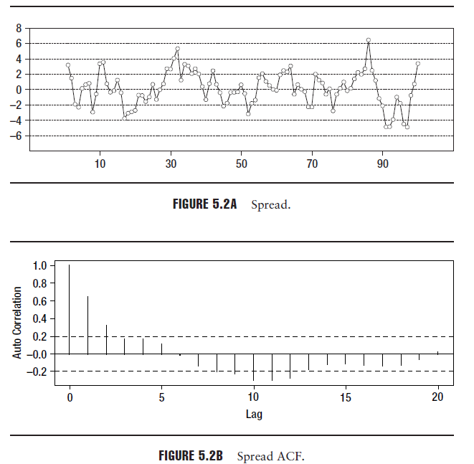

Slide 3
Stationary and Nonstationary
Stationary
For all t-s, and t-s-j

Slide 4
Stationary and Nonstationary
Spurious regression.
Downward bias
Using unit root test to verify.

Slide 5
Introduction
In chapter 5, we need three steps
Identification of the stock pairs
Cointegration testing
Trading rule formulation
This chapter will focus on cointegration testing and further analysis.

Slide 6
Introduction
We draw parallels between the common trends model for cointegration and the idea of APT.

Slide 7
Common Trends Cointegration Model
Inference 1: In a cointegration system with two time series, the innovations sequences derived from the common trend components must perfectly correlated.(correlation must be +1 or -1)

Slide 8
Common Trends Cointegration Model

Slide 9
Common Trends Cointegration Model
Inference 2: The cointegration coefficient may be obtained by a regression of the innovation sequences of the common trends against each other.

Slide 10
Discussion
First, the innovation sequences derived from the common trends of the two series must be identical up to a scalar.
Next, the specific components of the two series must be stationary.

Slide 11
Common Trends model and APT
Is the return due to the nonstationary trend component.
Is the return due to the stationary component.

Slide 12
Common Trends model and APT
Recalling the APT, the stock returns may be separated into common factor returns and specific returns.
If the two stocks share the same risk factor exposure profile, then the common factor returns for both the stocks must be the same.

Slide 13
Common Trends model and APT
Observation 1: A pairs of stocks with the same risk factor exposure profile satisfies the necessary conditions for cointegration.
Condition 1: The factor exposure vectors in this case are identical up to scalar.
Stock A:
Stock B:

Slide 14
Common Trends model and APT
If is the factor returns vector, and and are the specific returns for the stocks A and B.
then,
and,

Slide 15
Common Trends model and APT
Condition 2: Consider the linear combination of the returns.
Where,
If A and B are cointegrated, then the common factor return becomes zero.

Slide 16
Common Trends model and APT
Summary
The common factor return of a long-short portfolio of the two stocks is zero and the integration of the specific returns of the stocks is stationary, then the two stocks are cointegration.

Slide 17
The Distance Measure
The closer the absolute value of this measure to unity, the greater will be the degree of co-movement.

Slide 18
Interpreting The Distance Measure
Calculating the Cosine of the Angle between Two Vectors.

Slide 19
Interpreting The Distance Measure
Appendix: Eigenvalue Decomposition
Let
D is a diagonal matrix with the eigenvalues
U is a matrix with each column corresponding to
an eigenvectors.

Slide 20
Interpreting The Distance Measure
Geometric interpretation
Key to doing the geometric interpretation is the idea of eigenvalue decomposition.

Slide 21
Interpreting The Distance Measure

Slide 22
Reconciling Theory And Practice
Deviations from Ideal Conditions
When two stocks are not have their factor exposures perfectly aligned.
Signal-to-Noise(we need big SNR)

Slide 23
Example
Consider three stocks A, B, and C with factor exposures in a two factor as follows:

Slide 24
Example
Step1: Calculate the common factor variance and covariance.

Slide 25
Example
Step2: Calculate the correlation(absolute value of correlation is the distance measure)
If we have to choose one pair for purpose trading, our choice would therefore be the pair(A,B)

Slide 26
Example
Step3: Calculate the cointegration coefficient
We will discuss on the next chapter

Slide 27
Example
Step4: Calculate the residual common factor expose in paired portfolio. This is the exposure that causes mean drift.

Slide 28
Example
Step5: Calculate the common factor portfolio variance/variance of residual exposure.

Slide 29
Example
Step6: Calculate the specific variance of the portfolio.(assume the specific variance for all of the stocks to be 0.0016)

Slide 30
Example
Step7: Calculate the SNR ratio with white noise assumptions for residual stock return.

